Slide 1


Automation Testing for JPetStore​
(A online pet shop)
Presented By :​
Rodrieth Arvine​
Kumbha Somasankar​
Nivetha​
Kudumu Tejaswini ​
Banala PraveenKumar​
Sravani Songa​
Ramani Pavani​

Slide 2
INTRODUCTION
These tools and scripts simulate user interactions and validate the functionality of the software.​
Automation Testing involves the utilization of automated tools and scripts to perform tests on software applications. ​​
Automation testing provides benefits like faster test execution, repeatability, and consistent test results, while manual testing is limited by the speed and accuracy of human testers.​
​

Slide 3
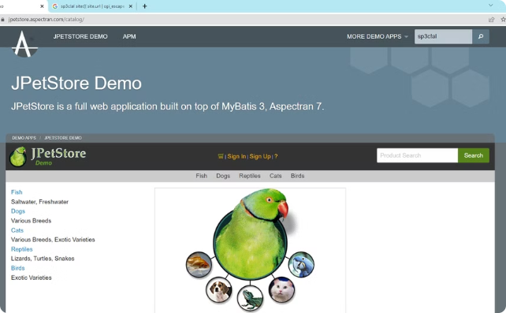
JPETSTORE DEMO (A Virtual Pet Store)
Welcoming Homepage
Simulated E-Commerce Experience​
Explore and Interact with Pet-Related Items​
Virtual Purchases​
Significance:​
Practical and Controlled Testing Environment ​
Demonstrates Automation's Efficiency and Accuracy​

Slide 4
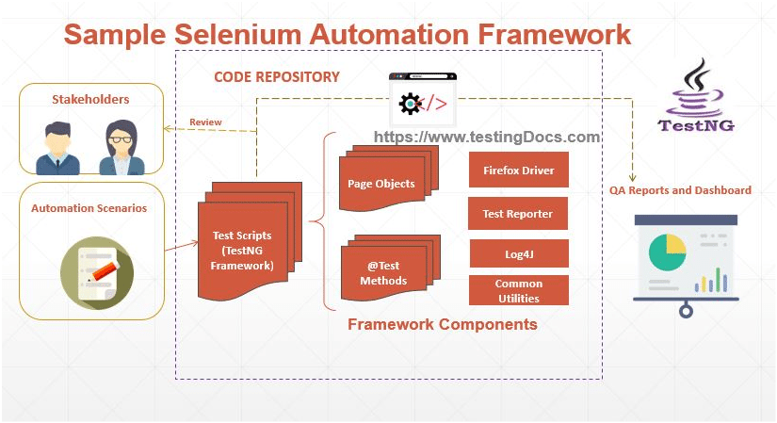
Our Journey with Automation
SELENIUM​
TESTNG​
PAGE OBJECT MODEL​
BDD Cucumber
API TESTING
EXTENT REPORT
​

Slide 5
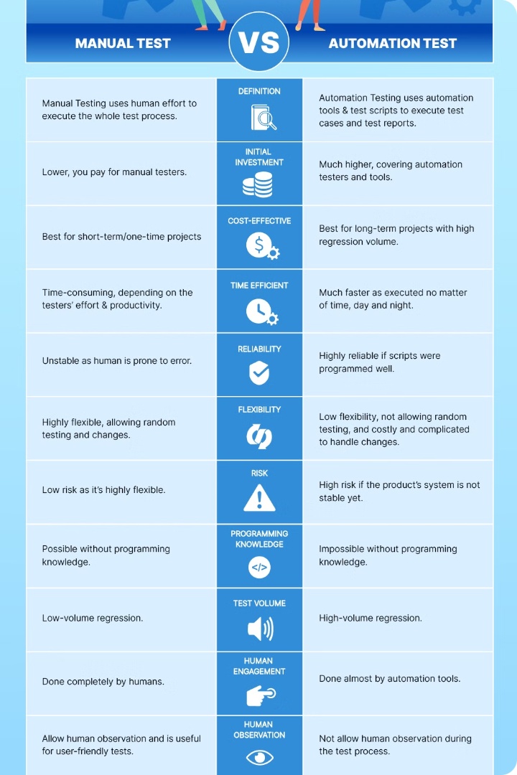
Automation TESTING over MANUAL TESTING
Speed & Efficiency​​
Consistency & Accuracy​​
Improved Test Coverage​​
Cost-Effective​​
Detailed Reporting​

Slide 6



Test Scenario Modules
Homepage
Search
Cart
Registration​
Search Pet​
Shopping Cart​
​
Sign in
Login in
Select Pet​
Update Cart​
Pet Details​
Payment & Checkout​
Generate Invoice
Account details

Slide 7
TEST FLOW
Home page
Registration
Login​
Search Pet​
Select Pet
Pet Details​
Add to cart
Update Cart​
Payment & Checkout​
Generate Invoice
Account details

Slide 8
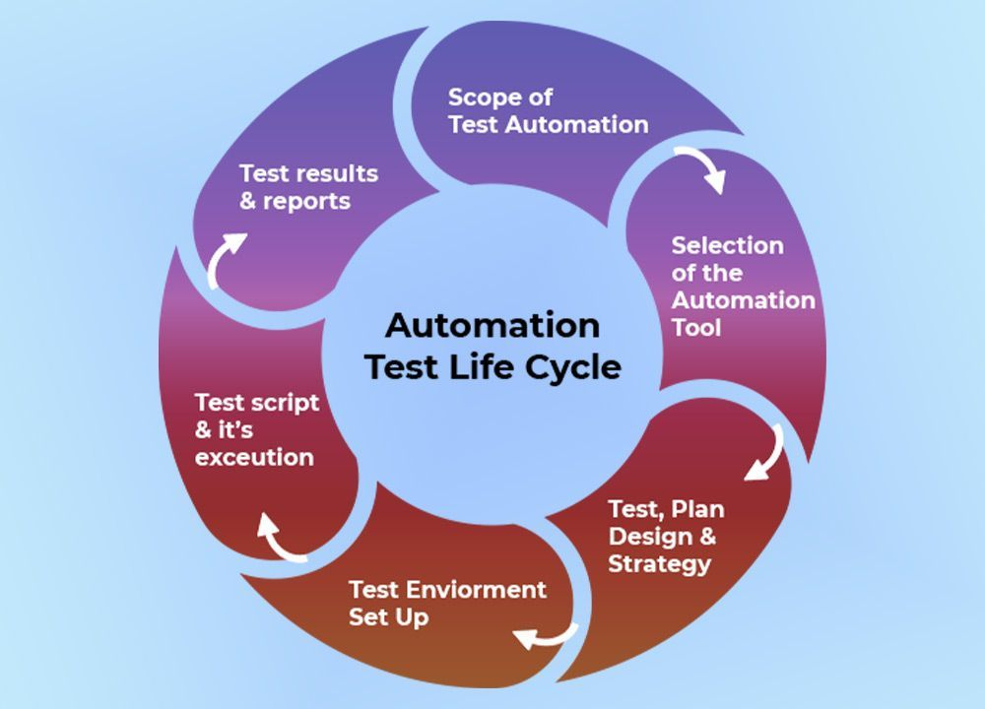
TEST EXECUTION
Test Execution is the process of performing test cases to identify bugs, errors and other potential issues that a software could have.
Test Execution Phases​
Test Execution Cycle​

Slide 9
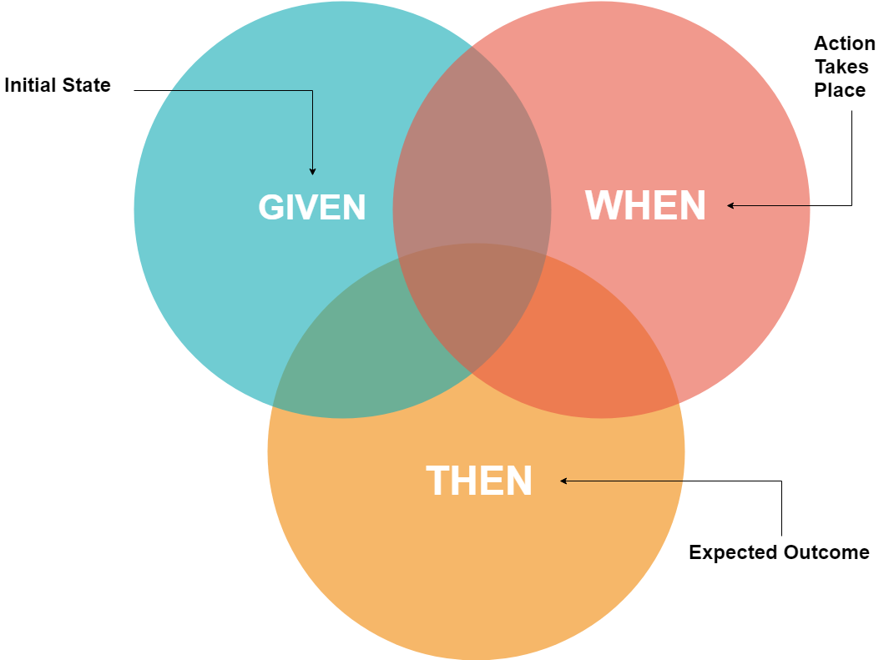

BDD CUCUMBER
Behavior-Driven Development (BDD)
In Cart functionality we used this approach. Approach to software development that emphasizes collaboration between stakeholders (business, development, testing).
Focuses on defining behavior using examples in natural language.
Cucumber Framework
BDD tool that supports the creation of executable specifications. Uses Gherkin syntax (Given-When-Then) for describing scenarios in plain text.
Integration and Benefits
Integrates with various programming languages (Java, Ruby, etc.) and testing frameworks (JUnit, TestNG). Enhances collaboration, clarity, and test automation efficiency.

Slide 10
TestNG
In Registration, Login, Homepage, search page, product details, and Account page we used this approach.
Testing framework for Java inspired by JUnit and NUnit. Supports various types of testing: unit, functional, integration.
Key Features
Annotations for test configuration and execution control.
Test grouping and prioritization.
Parameterization for data-driven testing.
Dependency management between tests.
Detailed HTML reports for test results.
Integration and Usage
Integrates with Maven, Jenkins for CI/CD.
Compatible with popular IDEs (Eclipse, IntelliJ).
Benefits
Enhances test flexibility and control.
Suitable for both small-scale and enterprise-level testing.

Slide 11
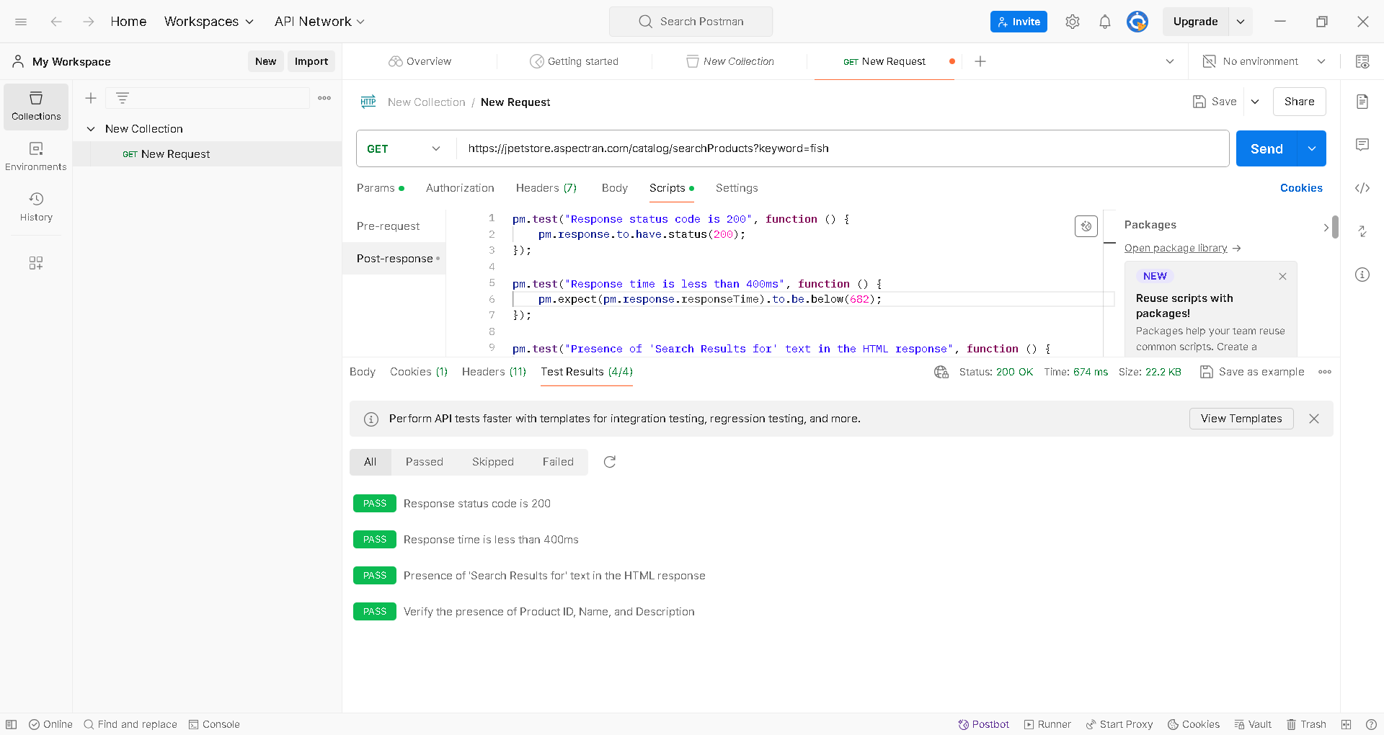
API TESTING USING POSTMAN

Slide 12

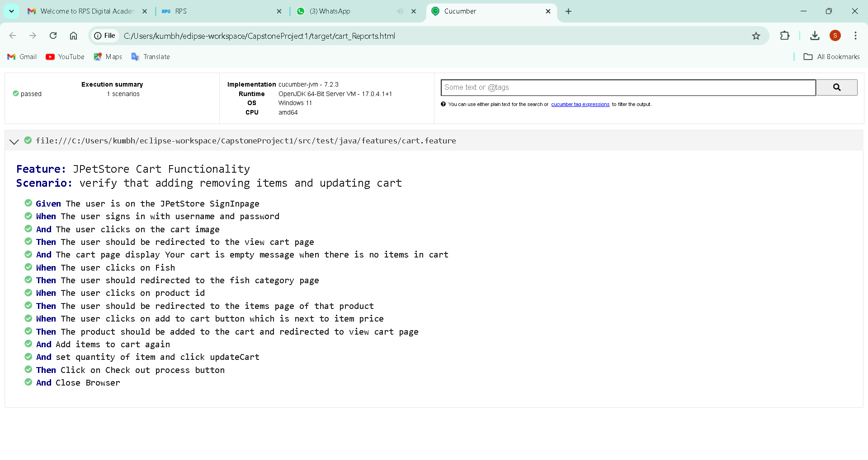
EXTENT REPORTS
Open-source reporting library useful for test automation. ​
Easily integrated with major testing frameworks like JUnit, TestNG, etc. ​
Extent Reports offer several advantages when compared to the built-in reports that are generated through JUnit and TestNG such as pie chart representation, test stepwise report generation, adding screenshots etc.​

Slide 13

CONCLUSION
Quality Assurance​
2. Efficiency Improvement​
3. Customer Satisfaction​
4. Consistency in Testing​
5. Long-Term Cost Savings​

Slide 14
THANK YOU

